Slide 1
Task 1
Task: Data Cleaning and Preprocessing
Objective: Clean and prepare a raw dataset (with nulls, duplicates, inconsistent formats). Tools: Excel / Python (Pandas)
Dataset Used: Netflix Movies and TV Shows

Slide 2
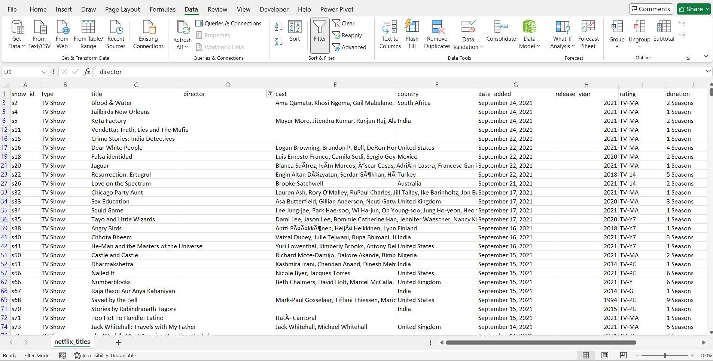
Identified Missing values using filters and conditional formatting.
Missing values were found in director, cast, country, date, rating and duration columns.

Slide 3
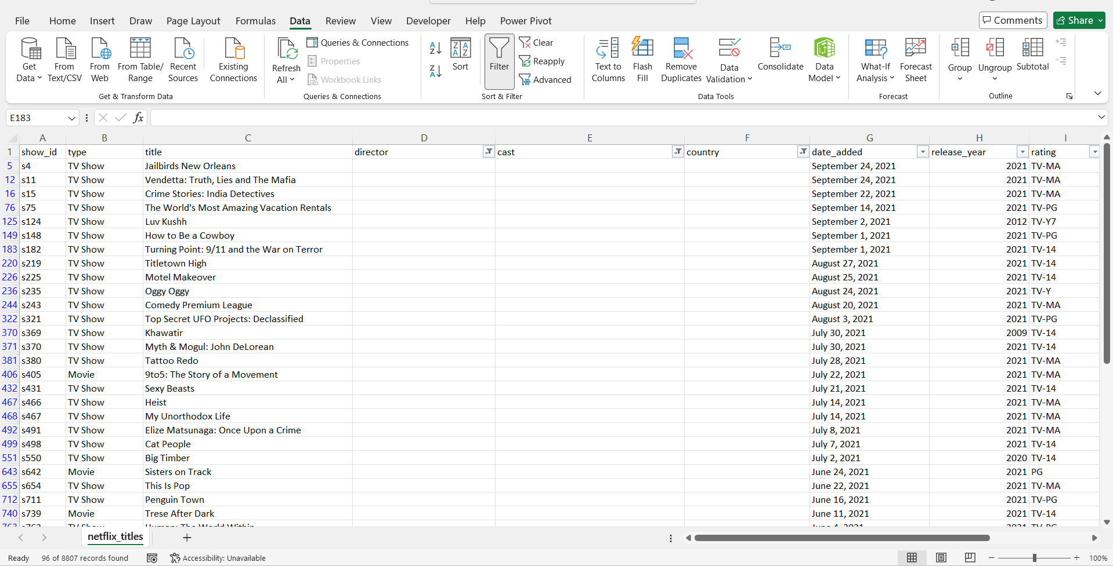

Slide 4
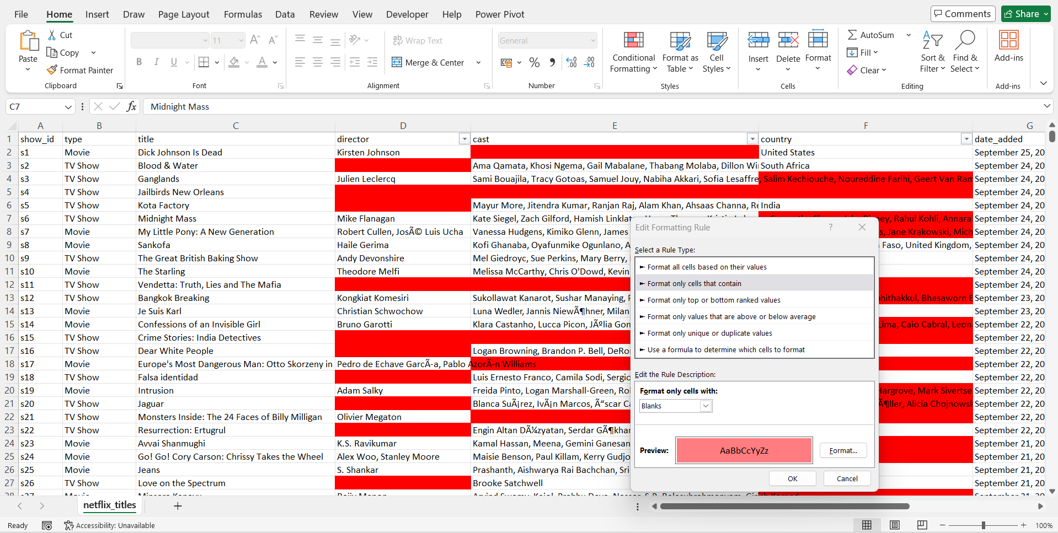
Used Conditional formatting to check null values visually:

Slide 5
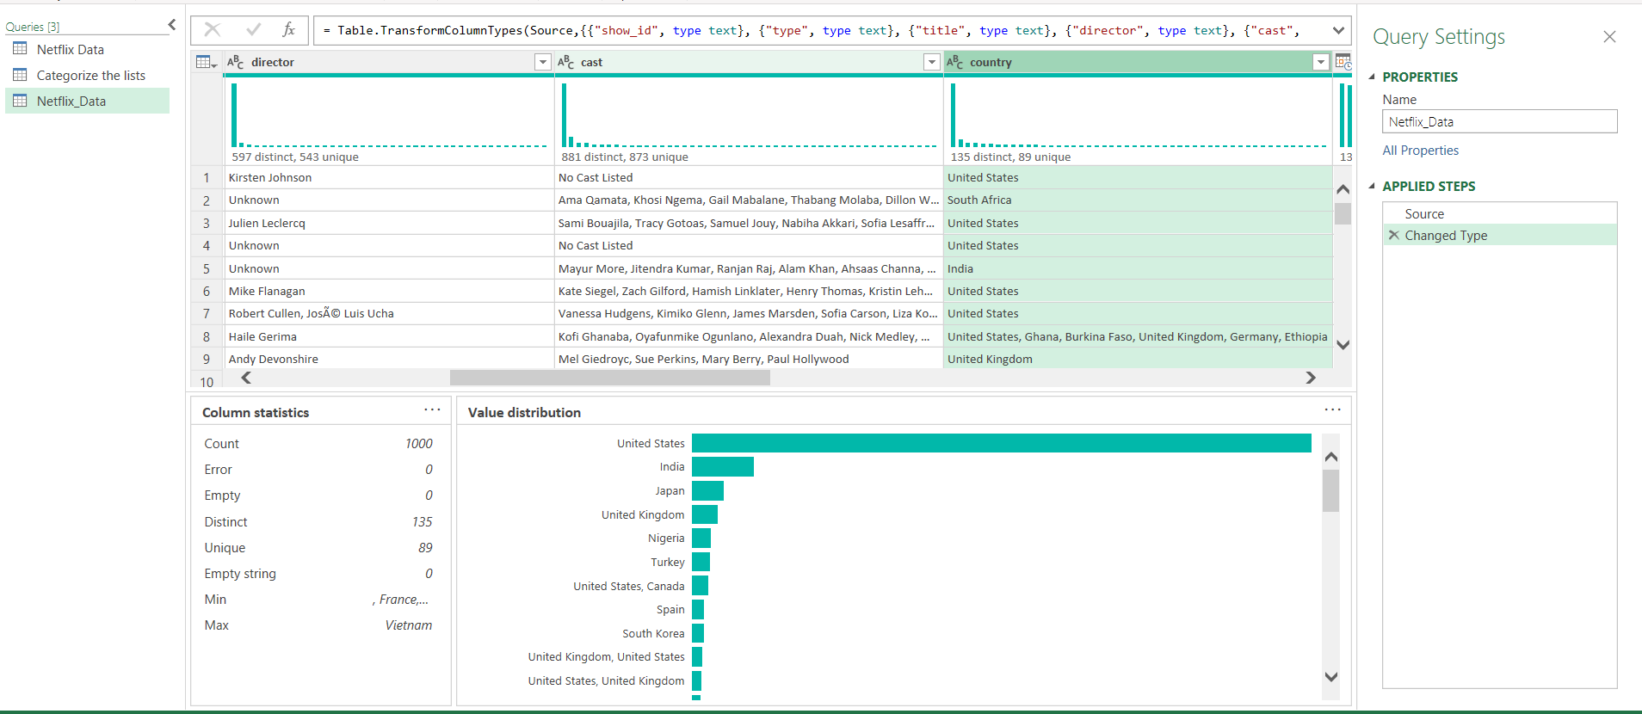
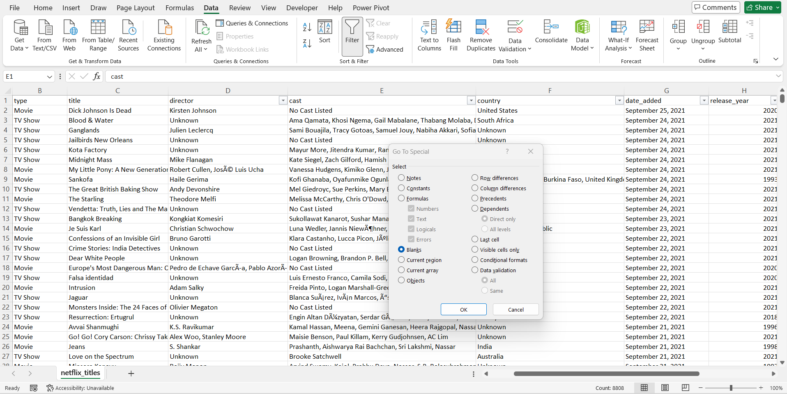
Handling Missing Values:
1)Director column: Filled blank values with word “Unknown” by using special blank method
2)Cast column: Filled blank values with word “No Cast Listed” by using special blank method
3)country: Populated the blank values with max country names that is United States(imputed with mode value see SS below)
4)Also eliminated rows for date, duration and rating as they were blank.

Slide 6
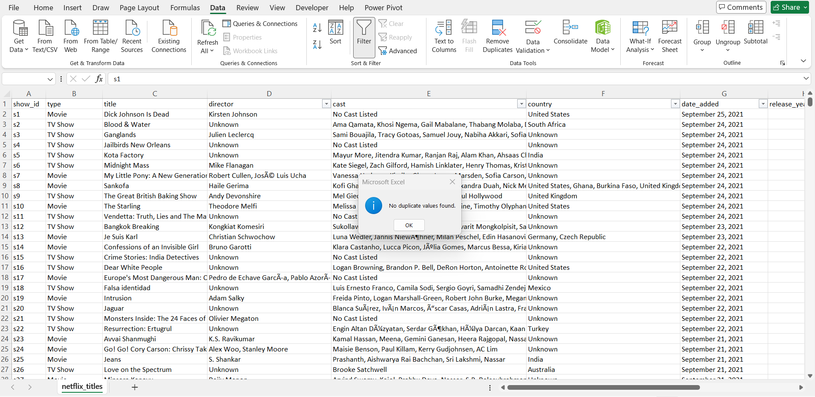
Removed duplicate values using “Remove duplicate function in Excel”.

Slide 7
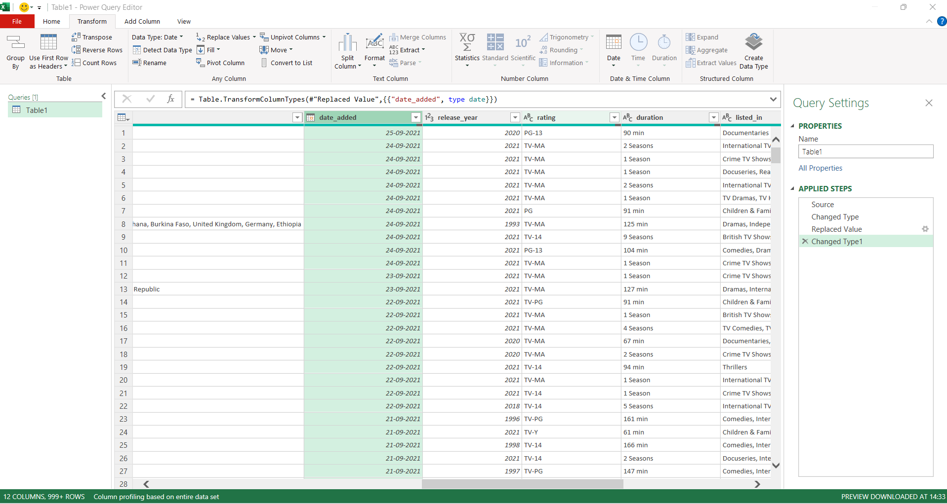
Converted Date data type to Date
Release_year to whole number

Slide 8
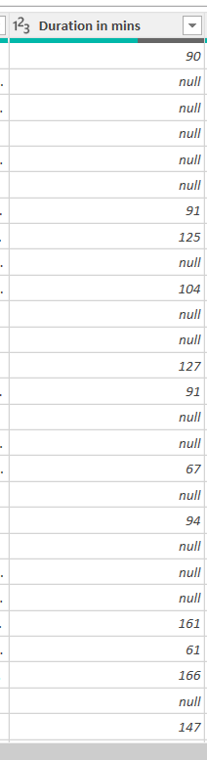
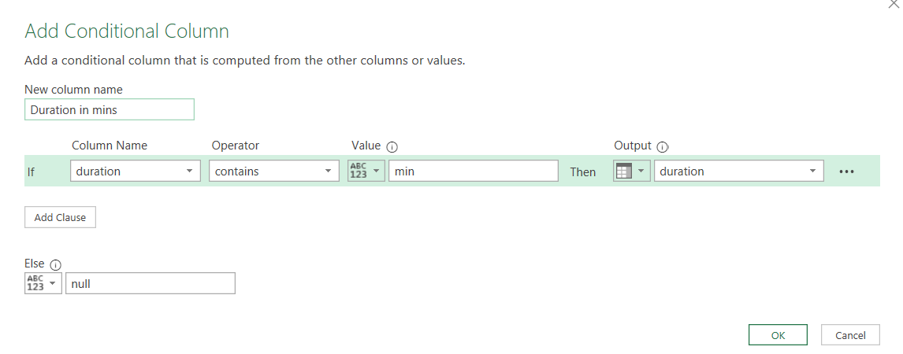
Added a conditional column for Duration to separate values measured in minutes, enabling accurate analysis of duration distribution.

Slide 9
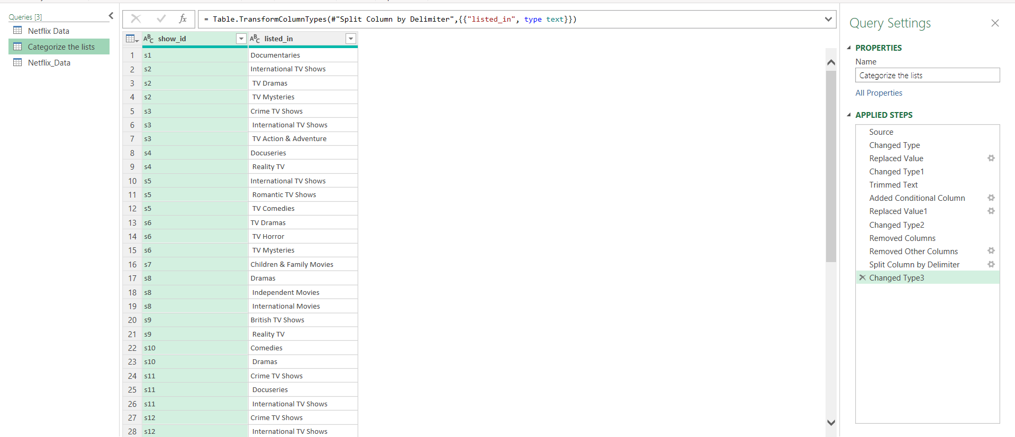
Split comma-separated values into a separate table to improve analysis and create clearer category-wise visuals

Slide 10
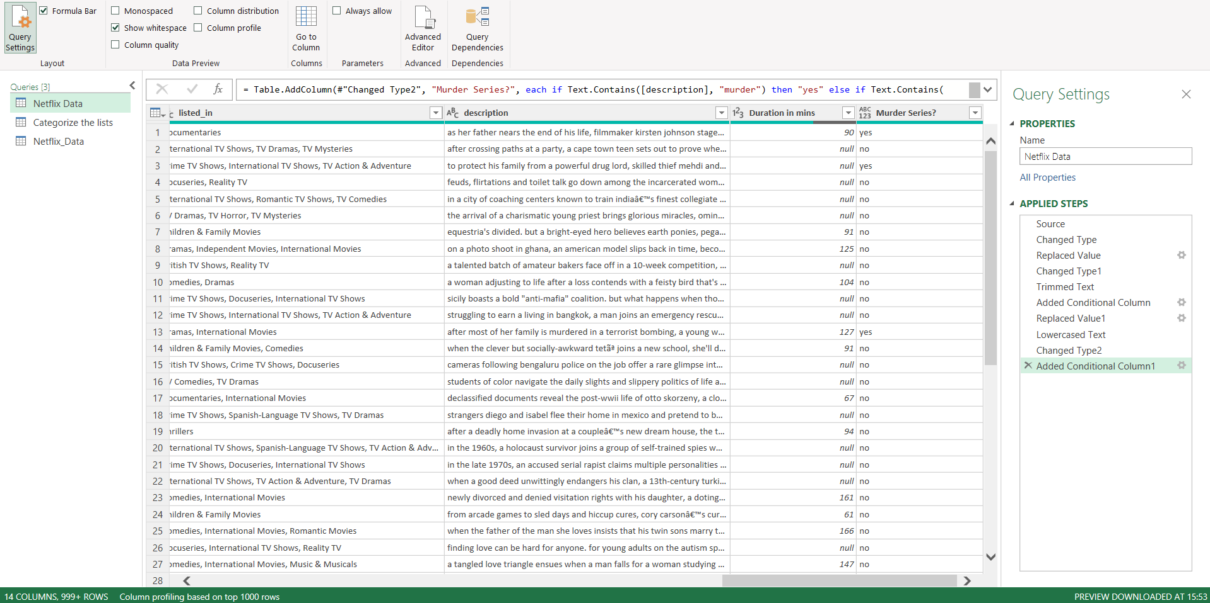
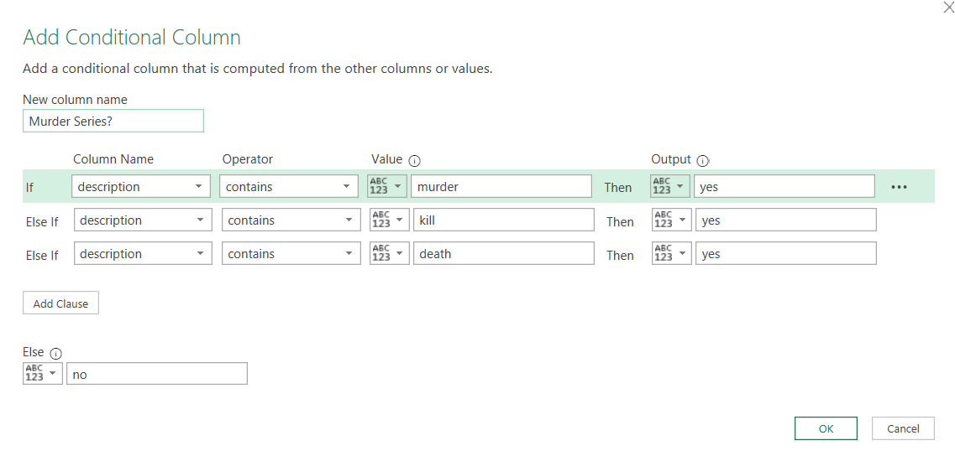
Used description column, trimmed it first and converted to lower case and added a conditional column to include murder series as shown below:

